Slide 1
Crack Detection in Concrete surfaces

Slide 2
Problem Statement
Build a classifier model that can reliably and accurately detect cracks in typical concrete surfaces

Slide 3

Why?

Slide 4
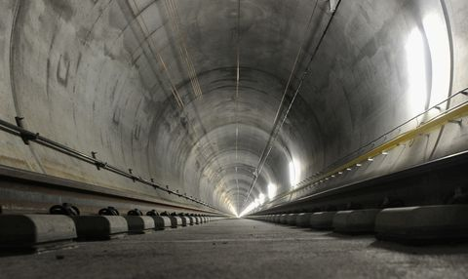
Why?
Downtown line is 44 km long

Slide 5
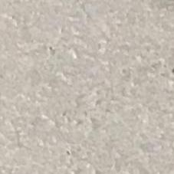
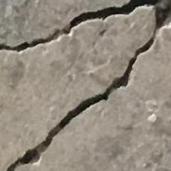
Dataset
Source | https://data.mendeley.com/datasets/5y9wdsg2zt/2 2018 – Özgenel, Ç.F., Gönenç Sorguç, A. “Performance Comparison of Pretrained Convolutional Neural Networks on Crack Detection in Buildings”, ISARC 2018, Berlin. Lei Zhang , Fan Yang , Yimin Daniel Zhang, and Y. J. Z., Zhang, L., Yang, F., Zhang, Y. D., & Zhu, Y. J. (2016). Road Crack Detection Using Deep Convolutional Neural Network. In 2016 IEEE International Conference on Image Processing (ICIP). http://doi.org/10.1109/ICIP.2016.7533052
Format | RGB Images of size 227 x 227 concrete surfaces: 20,000 positive class images (surfaces with cracks) 20,000 negative class images (surfaces without cracks)
Class 0 (Negative class)
Class 1 (Positive class)

Slide 6
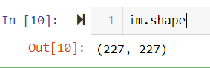
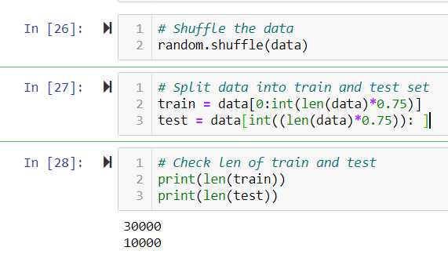
Data preprocessing
Import image data as array
Shuffle data and divide to train & test sets (0.75 train, 0.25 test)
Save data in h5py format

Slide 7
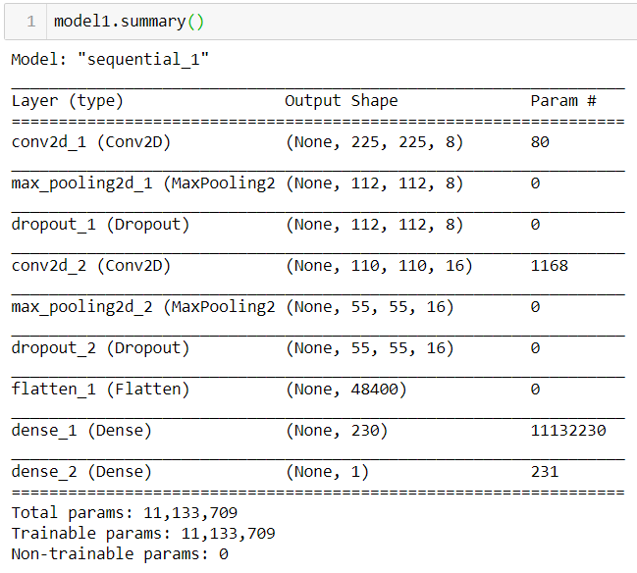
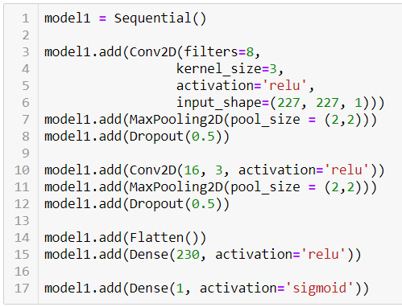
Model Construction – Deep Learning
Convolutional Neural Network – Model 1

Slide 8
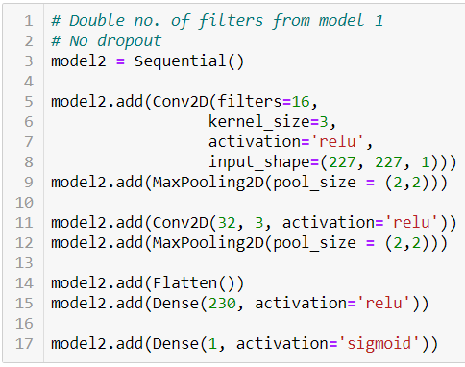
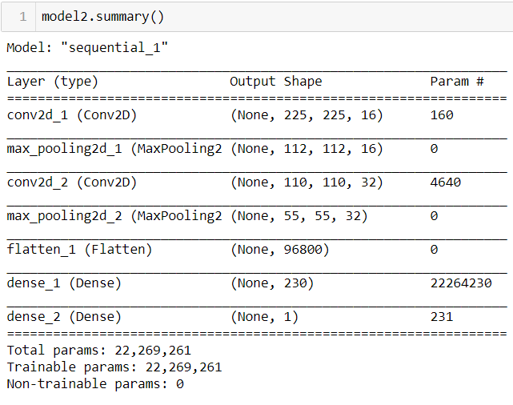
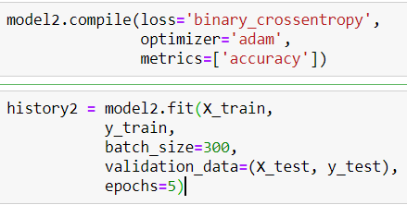
Model Construction – Deep Learning
Convolutional Neural Network – Model 2

Slide 9
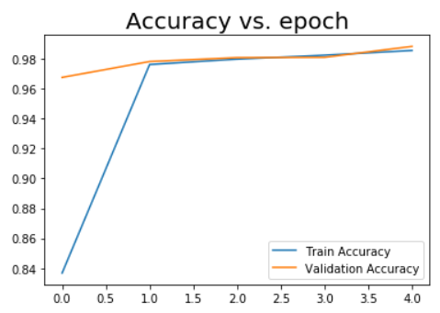
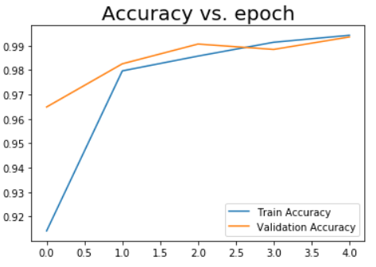
Model Construction – Deep Learning
Convolutional Neural Network – Model 2
1st run
2nd run

Slide 10
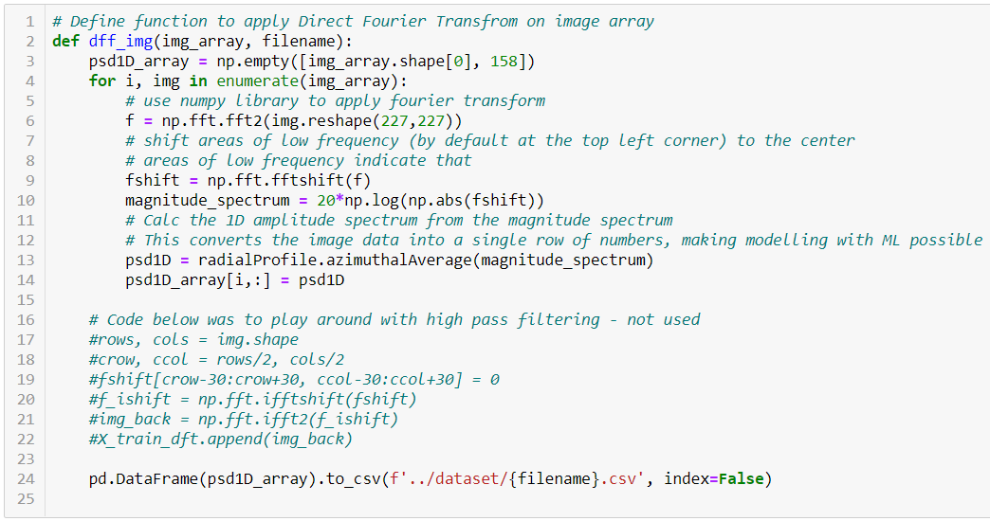
Model Construction – Machine Learning
Pre-processing
Fast Fourier Transform (FFT) on image array
Calculate Azimuthal average of Magnitude Spectrum
Obtain 1D amplitude spectrum

Slide 11
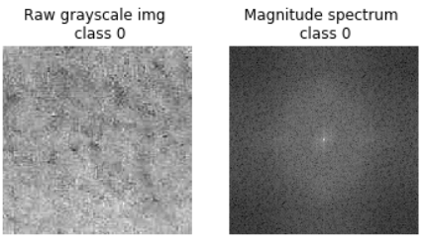
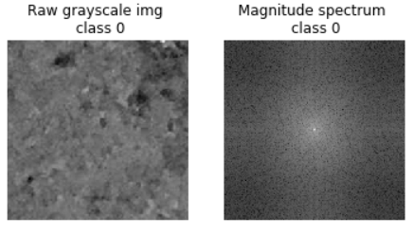
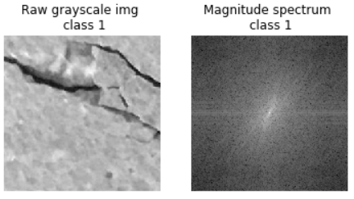
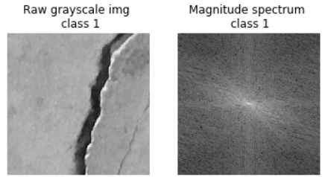
Model Construction – Machine Learning
Visualization of Magnitude Spectrum

Slide 12
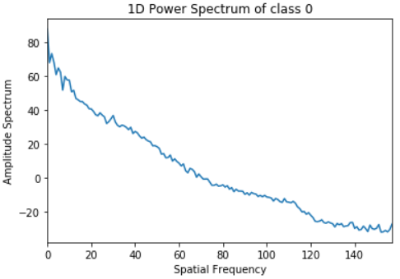
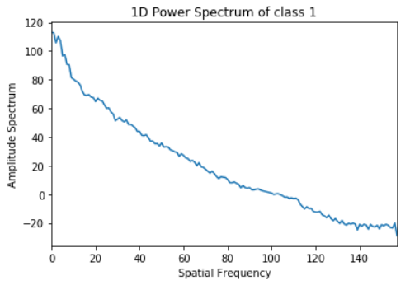
Model Construction – Machine Learning
Visualization of 1D Amplitude spectrum
Higher change in amplitude across spatial freq.
Lower change in amplitude across spatial freq.

Slide 13
Model Construction – Machine Learning
Evaluation of metrics
Model | Accuracy | F1-score | Recall | Specificity | Precision
Logistic Regression | 0.969 | 0.969 | 0.972 | 0.972 | 0.967
Random Forest | 0.976 | 0.976 | 0.976 | 0.976 | 0.976
AdaBoost | 0.969 | 0.969 | 0.967 | 0.971 | 0.971
XGBoost | 0.971 | 0.971 | 0.969 | 0.974 | 0.974
KNN | 0.974 | 0.974 | 0.974 | 0.975 | 0.975
SVM | 0.952 | 0.954 | 0.987 | 0.917 | 0.923

Slide 14
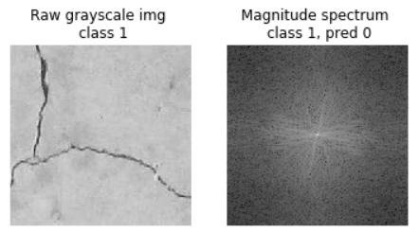
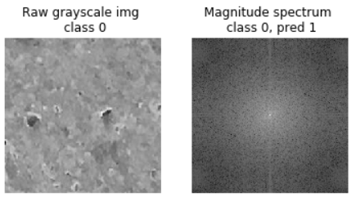
Model Evaluation – Machine Learning
Misclassified images
Random Forest classifier:
AdaBoost classifier:

Slide 15
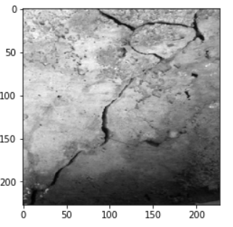
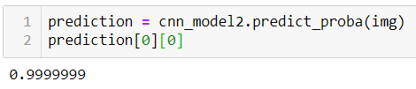
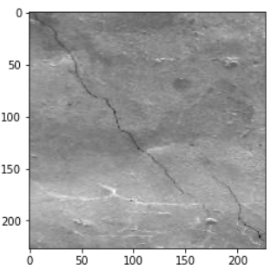
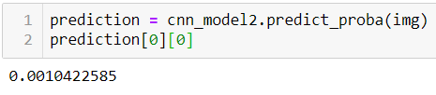
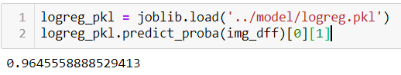
Models Performance
Testing on unseen images – Positive Class

Slide 16
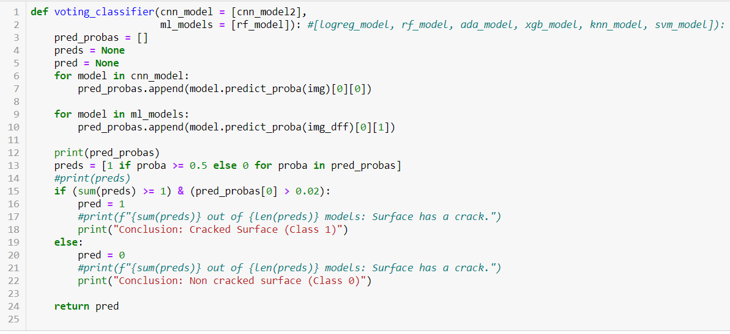
Meta classifier
Voting Classifier
2 models total

Slide 17
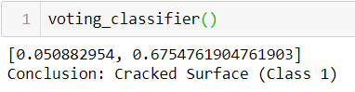
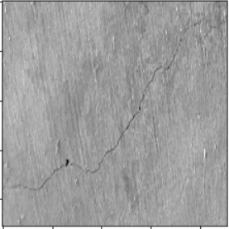
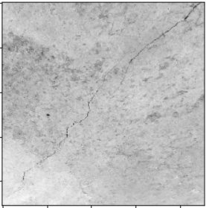
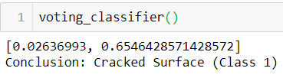
Voting Classifier – Class 1
UNSEEN DATA

Slide 18
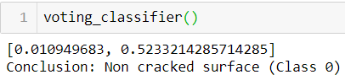
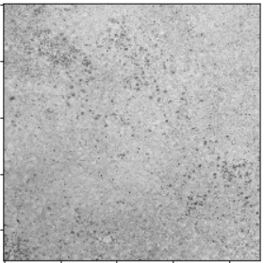
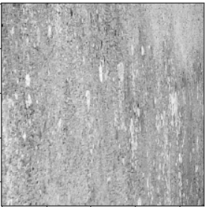
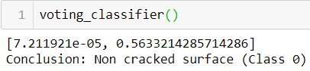
Voting Classifier – Class 0
UNSEEN DATA

Slide 19
Conclusion & Summary
CNN model | Machine Learning Models
Good at differentiating craters/bumps on surface from actual cracks | Bad at this
Bad at detecting narrow/small cracks | Good at this
Meta classifier (voting classifier) used to increase reliability
Limitations
Generally, 2 scenarios that caused misclassification:
Thin, narrow cracks
Surfaces with a lot of small craters
Cracks are only 1 type of defect
Future work
Extend to other types of defect

